Slide 1


Drops of LTSpice
Plotting the MEASURE results

Slide 2
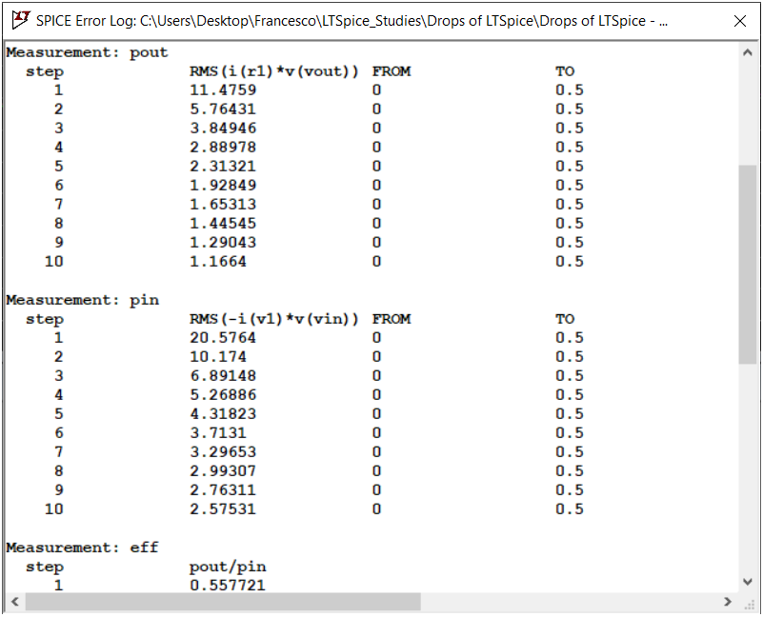
As we saw previously, .MEASURE allows you to take measurements and present them in a very convenient LOG.

Slide 3
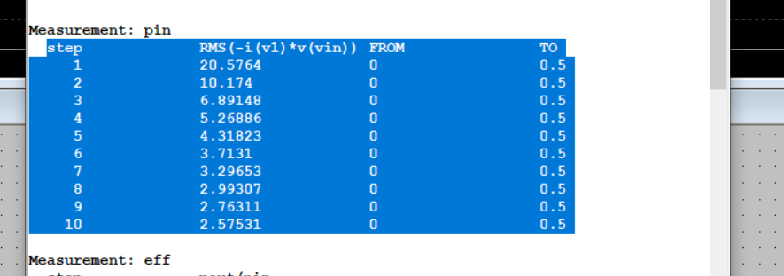
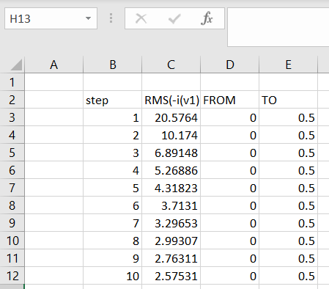
But I'm sure you tried to copy this data and paste it into EXCEL to create charts, am I right?
Calm down, there is a better way to do this!

Slide 4
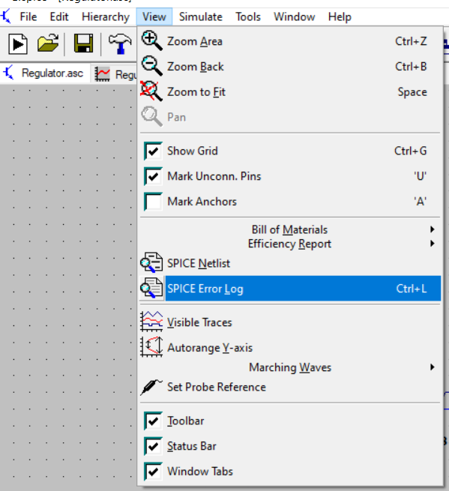
Once your simulation is ready, you open the SPICE Error Log to see the result.

Slide 5
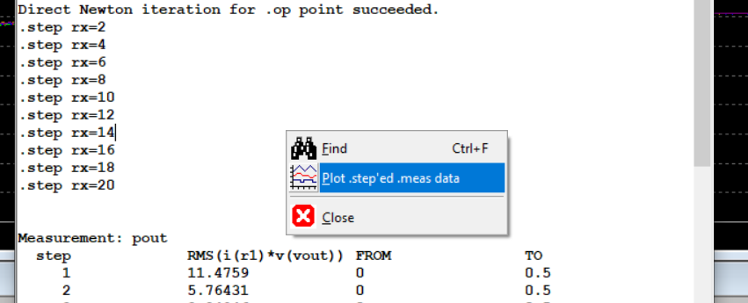
Right-click on the SPICE Error Log and select Plot .step'ed .meas data option.
A new window will open.

Slide 6
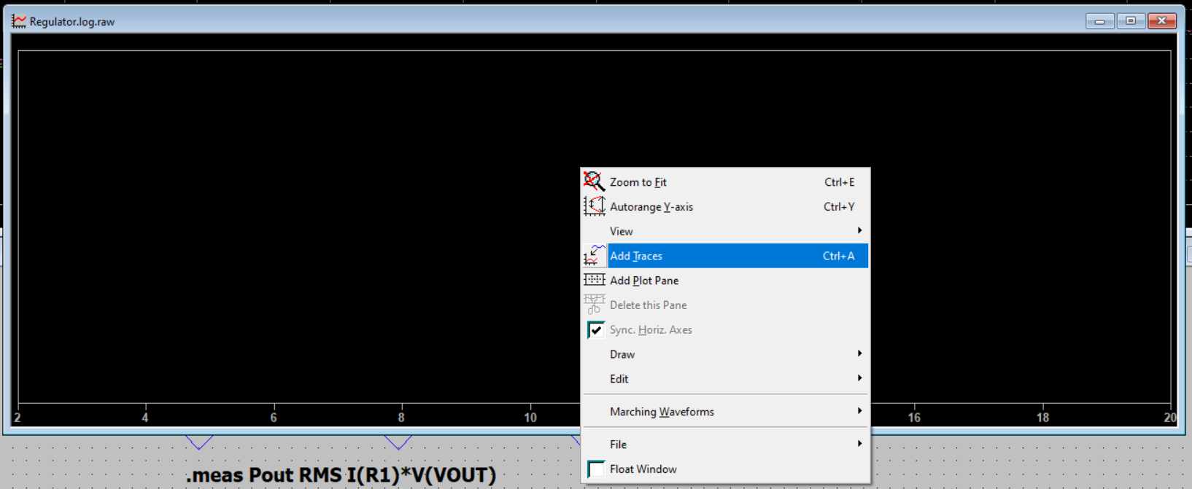
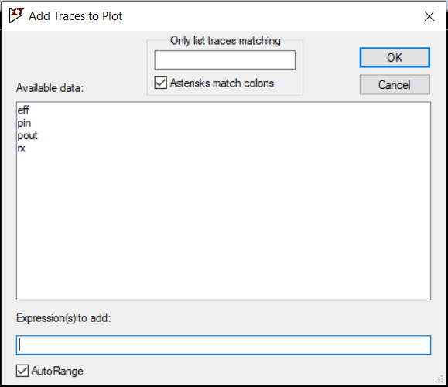
Right-click on it and select the
Add Traces option.
Measurements taken with .MEAS will appear.

Slide 7
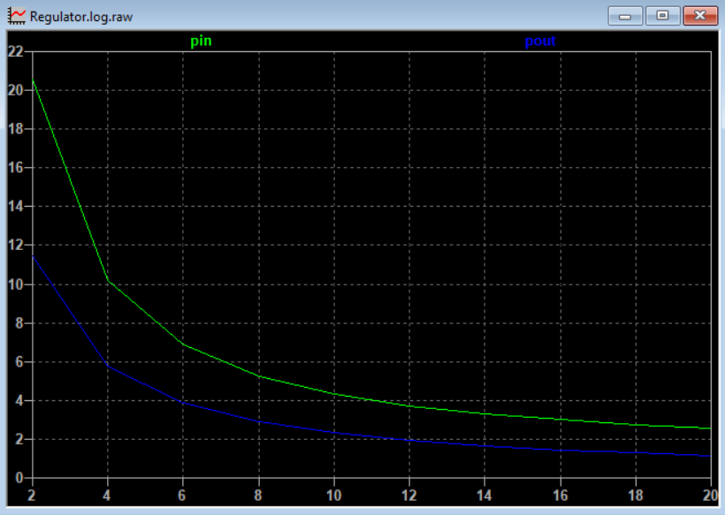
Here I have the input and output power, where the X axis is the RX load made with .STEP

Slide 8
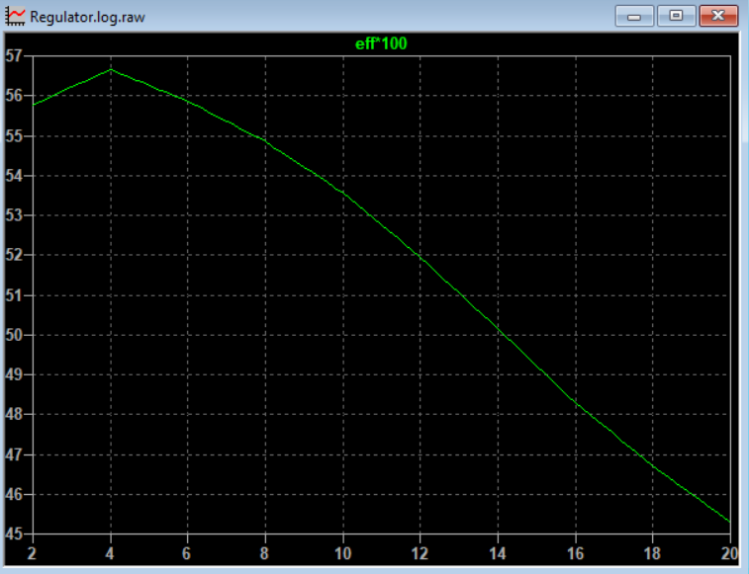
And here, I have a graph of efficiency in percentage.
Francesco Sacco
linkedin.com/in/saccofrancesco

